Slide 1
Job Tracking System
20254
User Interface Mockup

Slide 2
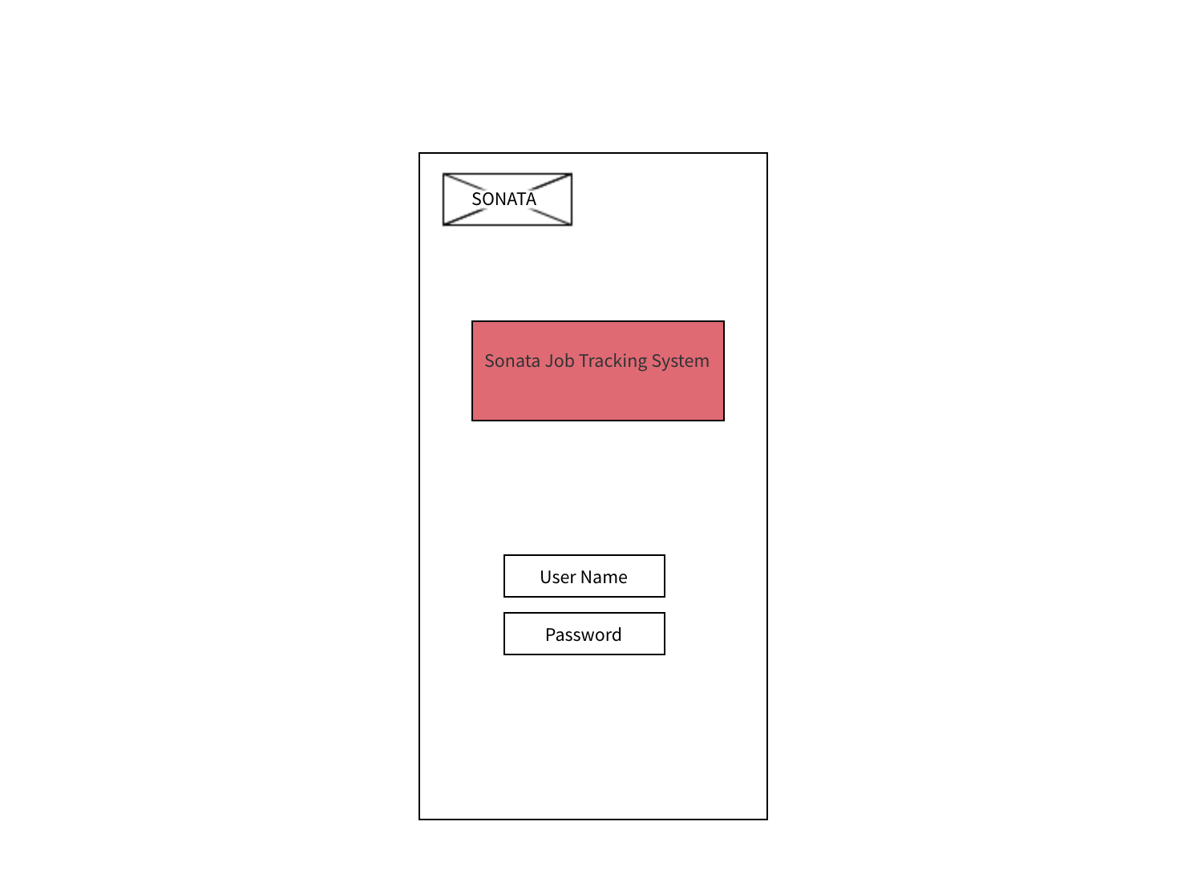
Login Page:

Slide 3
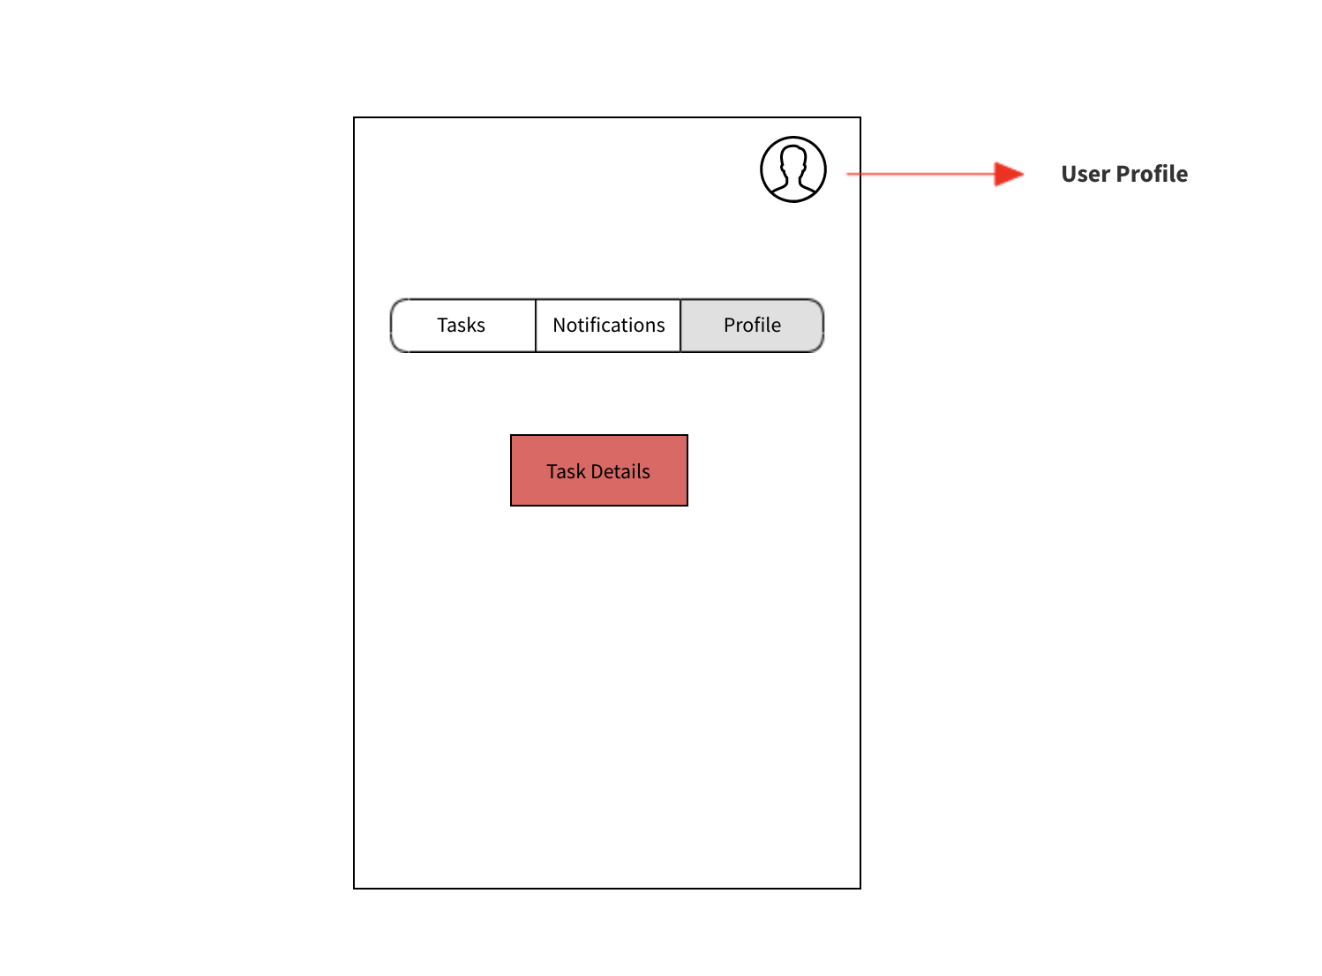
Outlook:

Slide 4
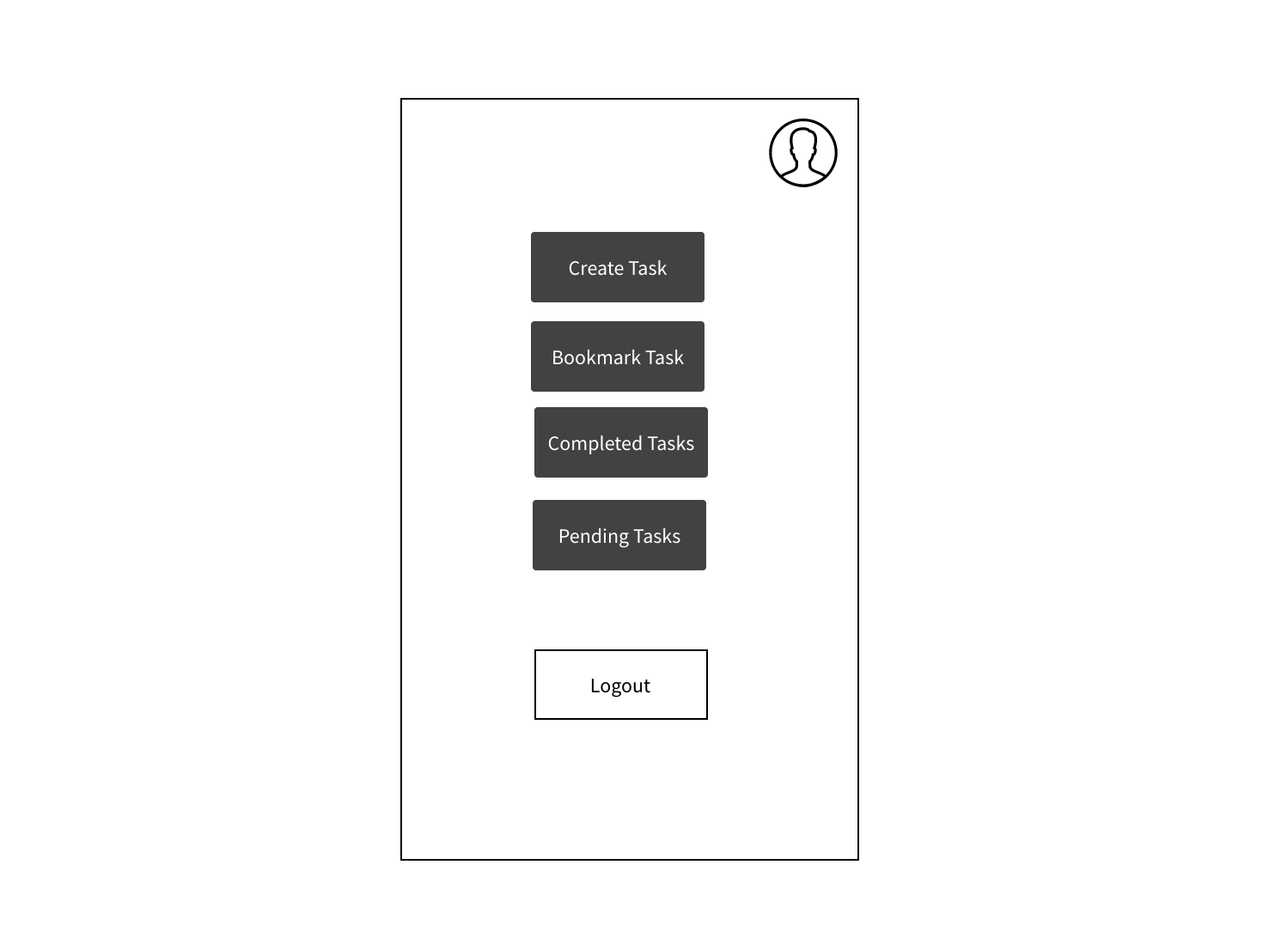
Task:

Slide 5
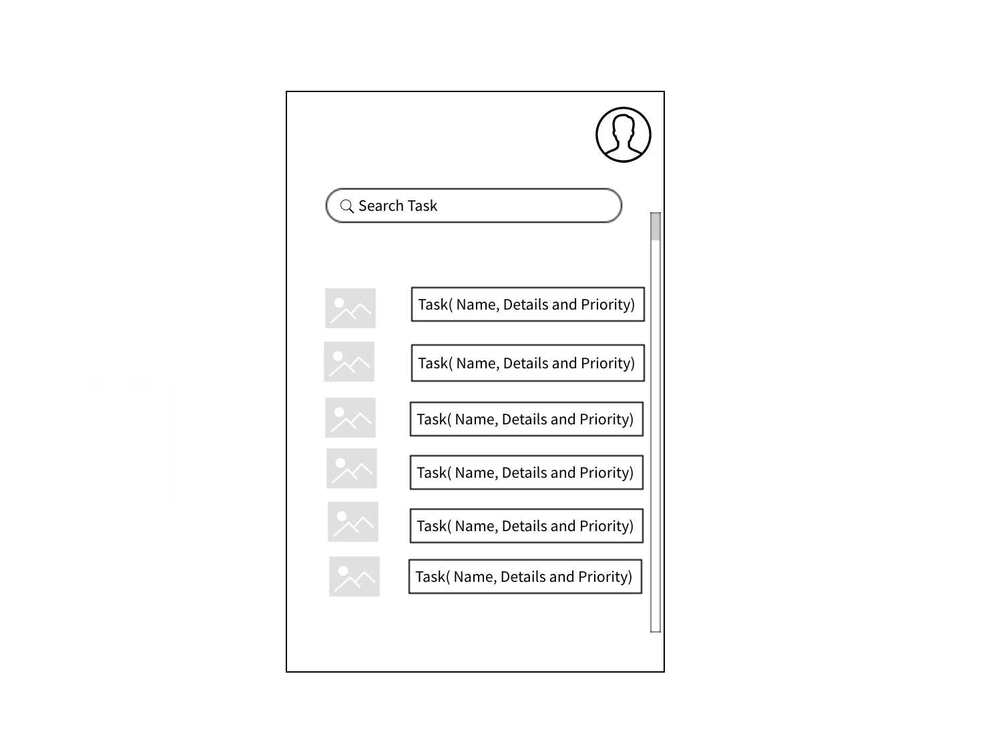
Task Details:

